Slide 1
Records (Structs)

Slide 2
Objectives
In this chapter, you will:
Learn about records (structs)
Examine various operations on a struct
Explore ways to manipulate data using a struct
Learn about the relationship between a struct and functions
Discover how arrays are used in a struct
Learn how to create an array of struct items

Slide 3
Records (structs)
struct: collection of a fixed number of components (members), accessed by name
Members may be of different types
Syntax:

Slide 4
Records (structs) (continued)
A struct is a definition, not a declaration

Slide 5
Records (structs) (continued)

Slide 6
Accessing struct Members
The syntax for accessing a struct member is:
The dot (.) is an operator, called the member access operator

Slide 7
Accessing struct Members (continued)
To initialize the members of newStudent:
newStudent.GPA = 0.0;
newStudent.firstName = "John";
newStudent.lastName = "Brown";

Slide 8
Accessing struct Members (continued)
More examples:
cin >> newStudent.firstName;
cin >> newStudent.testScore >> newStudent.programmingScore;
score = (newStudent.testScore + newStudent.programmingScore) / 2;
if (score >= 90)
newStudent.courseGrade = 'A';
else if (score >= 80)
newStudent.courseGrade = 'B';
else if (score >= 70)
newStudent.courseGrade = 'C';
else if (score >= 60)
newStudent.courseGrade = 'D';
else
newStudent.courseGrade = 'F';

Slide 9
Assignment
Value of one struct variable can be assigned to another struct variable of the same type using an assignment statement
The statement:
student = newStudent;
copies the contents of newStudent into student
http://codepad.org/jaBmXBwX

Slide 10
Assignment (continued)
The assignment statement:
student = newStudent;
is equivalent to the following statements:
student.firstName = newStudent.firstName;
student.lastName = newStudent.lastName;
student.courseGrade = newStudent.courseGrade;
student.testScore = newStudent.testScore;
student.programmingScore = newStudent.programmingScore;
student.GPA = newStudent.GPA;

Slide 11
Comparison (Relational Operators)
Compare struct variables member-wise
No aggregate relational operations allowed
To compare the values of student and newStudent:

Slide 12
Input/Output
No aggregate input/output operations on a struct variable
Data in a struct variable must be read one member at a time
The contents of a struct variable must be written one member at a time

Slide 13
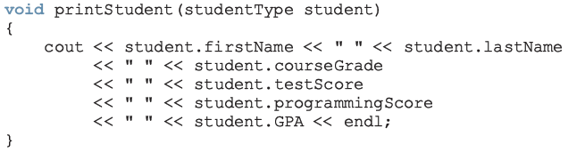
struct Variables and Functions
A struct variable can be passed as a parameter by value or by reference
A function can return a value of type struct

Slide 14
Arrays versus structs

Slide 15
Arrays in structs
Two key items are associated with a list:
Values (elements)
Length of the list
Define a struct containing both items:

Slide 16
Arrays in structs (continued)

Slide 17


Slide 18
structs in Arrays

Slide 20
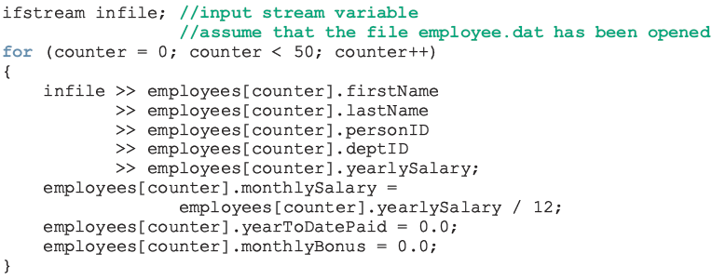

Slide 21
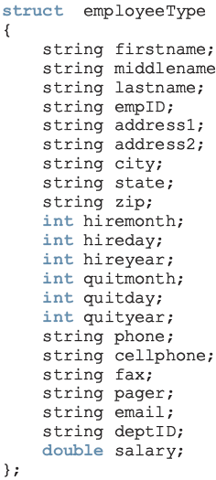
structs within a struct
http://codepad.org/u789FvSv
versus

Slide 22
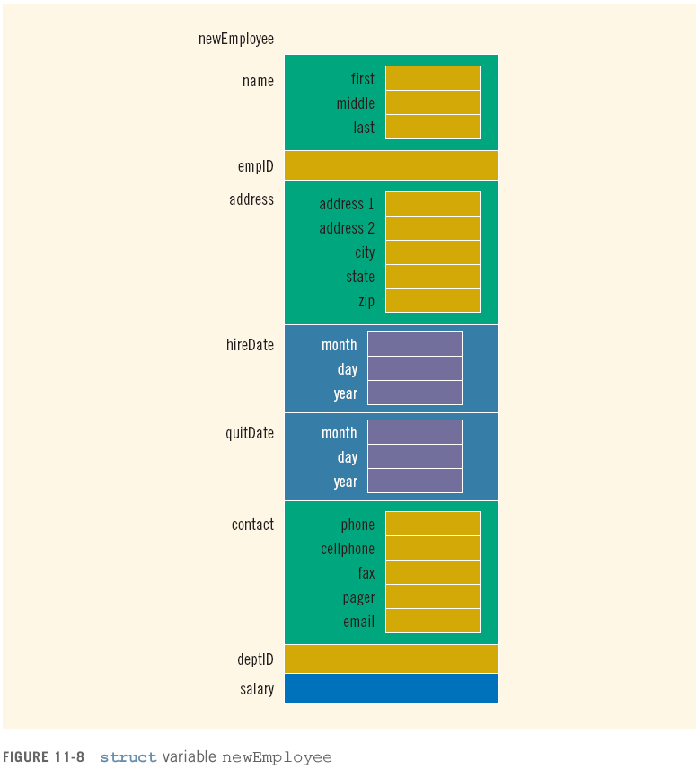

Slide 23
Programming Example: Sales Data Analysis
A company has six salespeople
Every month they go on road trips to sell the company’s product
At the end of each month, the total sales for each salesperson, salesperson’s ID, and the month are recorded in a file
At the end of each year, the manager of the company asks for a report

Slide 24
Programming Example: Output Format
----------- Annual Sales Report -------------
ID QT1 QT2 QT3 QT4 Total
______________________________________________________________
12345 1892.00 0.00 494.00 322.00 2708.00
32214 343.00 892.00 9023.00 0.00 10258.00
23422 1395.00 1901.00 0.00 0.00 3296.00
57373 893.00 892.00 8834.00 0.00 10619.00
35864 2882.00 1221.00 0.00 1223.00 5326.00
54654 893.00 0.00 392.00 3420.00 4705.00
Total 8298.00 4906.00 18743.00 4965.00
Max Sale by SalesPerson: ID = 57373, Amount = $10619.00
Max Sale by Quarter: Quarter = 3, Amount = $18743.00
QT1 stands for quarter 1 (months 1 to 3), QT2 for quarter 2 (months 4 to 6), QT3 for quarter 3 (months 7 to 9), and QT4 for quarter 4 (months 10 to 12)

Slide 25
Programming Example: Output Format (continued)
The salespeople IDs are stored in one file; sales data are stored in another file
The sales data is in the following form:
salesPersonID month saleAmount
.
.
.
Sales data are not ordered

Slide 26
Programming Example: Input/Output
Input: file containing each salesperson’s ID and a second file containing the sales data
Output: file containing annual sales report in the above format

Slide 27
Programming Example: Problem Analysis
Main components for each salesperson:
ID
Quarterly sales amount
Total annual sales amount
Use a struct to group the components
Six people: array of size six
Program requires total sales for each quarter
Use array of size four to store the data

Slide 28
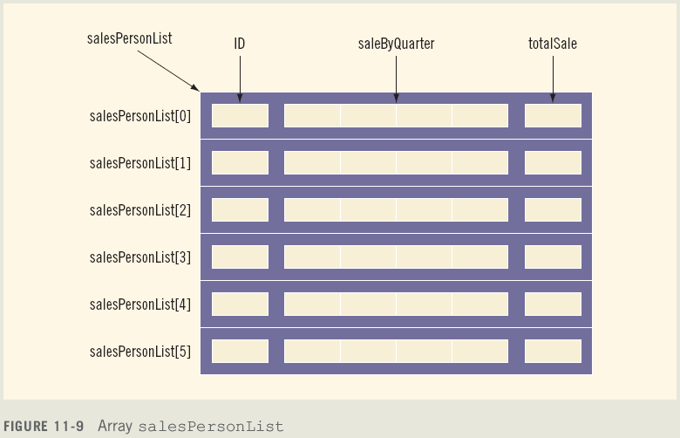
Programming Example: Problem Analysis (continued)

Slide 29
Programming Example: Program Analysis (continued)
Read the salespeople IDs into the array salesPersonList
Initialize the quarterly sales and total sales for each salesperson to 0

Slide 30
Programming Example: Program Analysis (continued)
For each entry in the file with the sales data:
Read ID, month, sale amount for the month
Search salesPersonList to locate the component corresponding to this salesperson
Determine the quarter corresponding to the month
Update the sales for the quarter by adding the sale amount for the month

Slide 31
Programming Example: Program Analysis (continued)
Once the sales data file is processed:
Calculate the total sale by salesperson
Calculate the total sale by quarter
Print the report

Slide 32
Programming Example: Algorithm Design
Translates into the following algorithm:
Initialize the array salesPersonList
Process the sales data
Calculate the total sale by salesperson
Calculate the total sale by quarter
Print the report
Calculate and print maximum sale by salesperson
Calculate and print maximum sale by quarter

Slide 33
Programming Example: Main Algorithm
Declare the variables
Prompt user to enter name of file containing the salesperson’s ID data
Read the name of the input file
Open the input file
If input file does not exist, exit
Initialize the array salesPersonList by calling the function initialize

Slide 34
Programming Example: Main Algorithm (continued)
Close input file containing salesperson’s ID
Prompt user to enter name of file containing sales data
Read the name of the input file
Open the input file
If input file does not exist, exit
Prompt user to enter name of output file
Read the name of the output file

Slide 35
Programming Example: Main Algorithm (continued)
Open the output file
Output data to two decimal places
Process sales data
Call the function getData
Calculate the total sale by quarter by calling the function saleByQuarter
Calculate the total sale by salesperson by calling the function totalSaleByPerson

Slide 36
Programming Example: Main Algorithm (continued)
Print the report in the tabular form; call the function printReport
Find and print the salesperson who produces the maximum sales for the year by calling maxSaleByPerson
Find and print the quarter producing the maximum sale for the year by calling maxSaleByQuarter
Close files

Slide 37
Summary
struct: collection of a fixed number of components
Components can be of different types
Called members
Accessed by name
struct is a reserved word
No memory is allocated for a struct
Memory when variables are declared

Slide 38
Summary (continued)
Dot (.) operator: member access operator
Used to access members of a struct
The only built-in operations on a struct are the assignment and member access
Neither arithmetic nor relational operations are allowed on structs
struct can be passed by value or reference
A function can return a value of type struct
structs can be members of other structs

